Slide 1

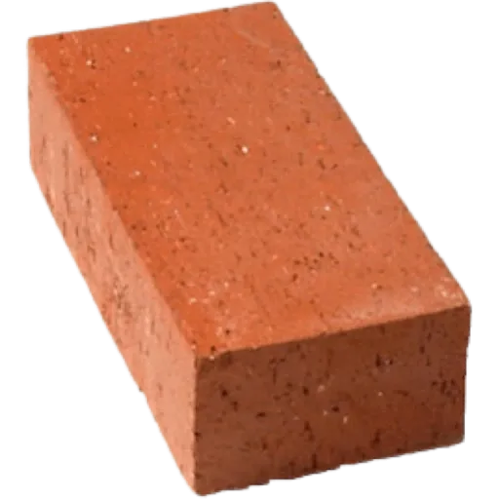

GLOWSTONE
Remi Maskulin, Leo Leerilä, Oleg Dukalskiy, Eeli Mäkinen and Evil Larry
Ryhmä 1

Slide 2

Use of AI
  This was made fully by humans, ew
GitHub link - https://github.com/LeoLeerila/Glowstone
Trello link - https://trello.com/b/xQvpwM4z/sep1glowstone
ITS AN AUTHENTIC HAND MADE NFT!!!!!!

Slide 3
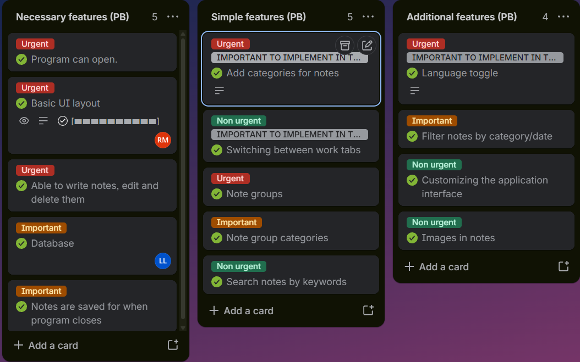
Product Backlog and development process
We implemented the majority of necessary features first, before touching non-essential features.
Group members took tasks under their responsibility
All features got implemented on a timely manner
Boring ass trello bruh

Slide 4
Sprint 1
Statistics on the sprint implementation:
  Sprint Master: Remi
  Sprint Backlog
    Chose project topic and assigned responsibility roles
    Project Plan & Vision documents
    Product backlog and user stories

Slide 5
Sprint 2
Statistics on the sprint implementation:
  Sprint Master: Oleg
  Sprint Backlog
    Done & Released
      Frontend basic layout and frontend-only methods
      Backend implemented with SCRUM
      JaCoCo implemented
      JUnit starter tests
    Testing
      Basic testing implemented for backend

Slide 6
Sprint 3
Statistics on the sprint implementation:
  Sprint Master: Leo
  Sprint Backlog
    Done & Released
      Frontend communication with Backend
      Database implemented
      Jenkins implemented
      Remaining frontend features implemented
    Testing
      Implemented new tests with Database connection in mind
      Some tests we’re left TBA

Slide 7

Sprint 4
Statistics on the sprint implementation:
  Sprint Master: Eeli
  Sprint Backlog
    Done & Released
      Docker image implemented
      Remaining JUnit tests
    Postpone
      Frontend UI visual enhancements

Slide 8
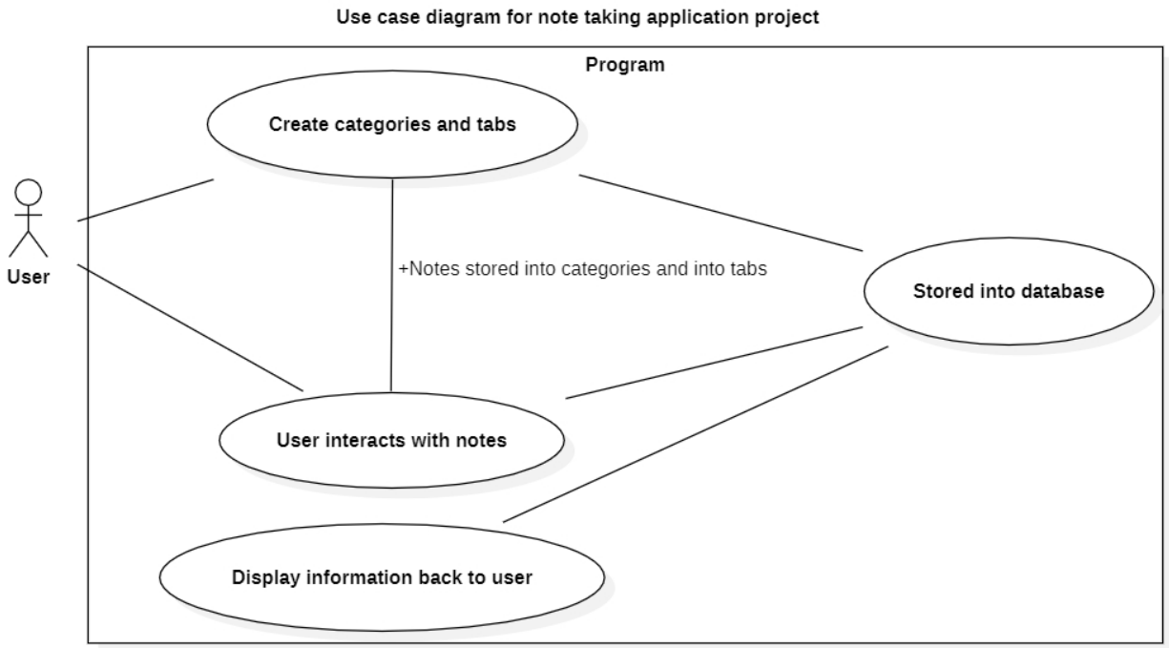
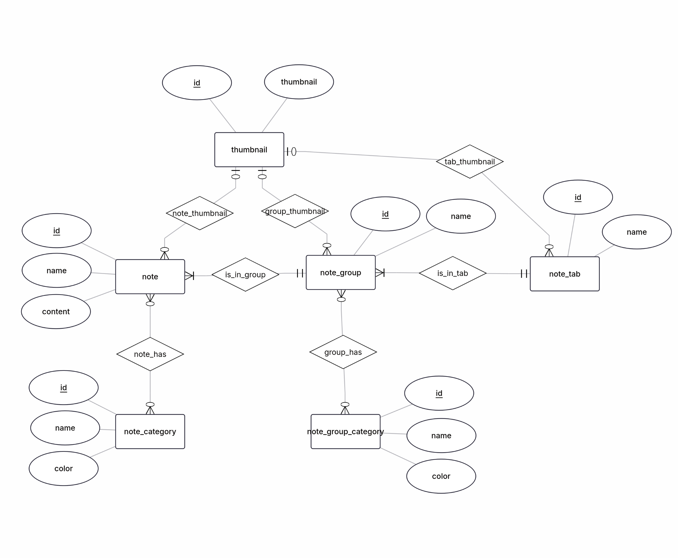
Architectural Design

Slide 9


Applied Technologies
Junit
Jacoco
Jenkins
Docker
JavaFX
MariaDB

Slide 10
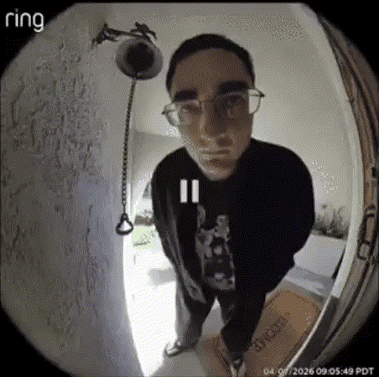

Demo
5 minutes maximum
  Prototype demo (Docker image)
Lettuce begin the show
HEY ITS ME ITS VERITY

Slide 11



Validity and reliability of your Solution
How did you ensure your software is reliable?
We opened the program. It work. 👍 (ad-hoc testing)
Junit tests used to ensure methods work as expected.

Slide 12
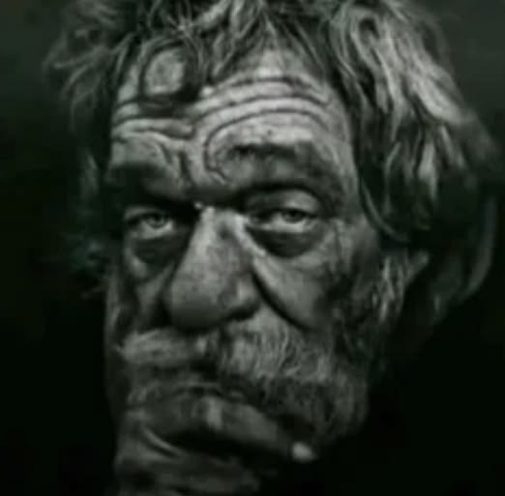





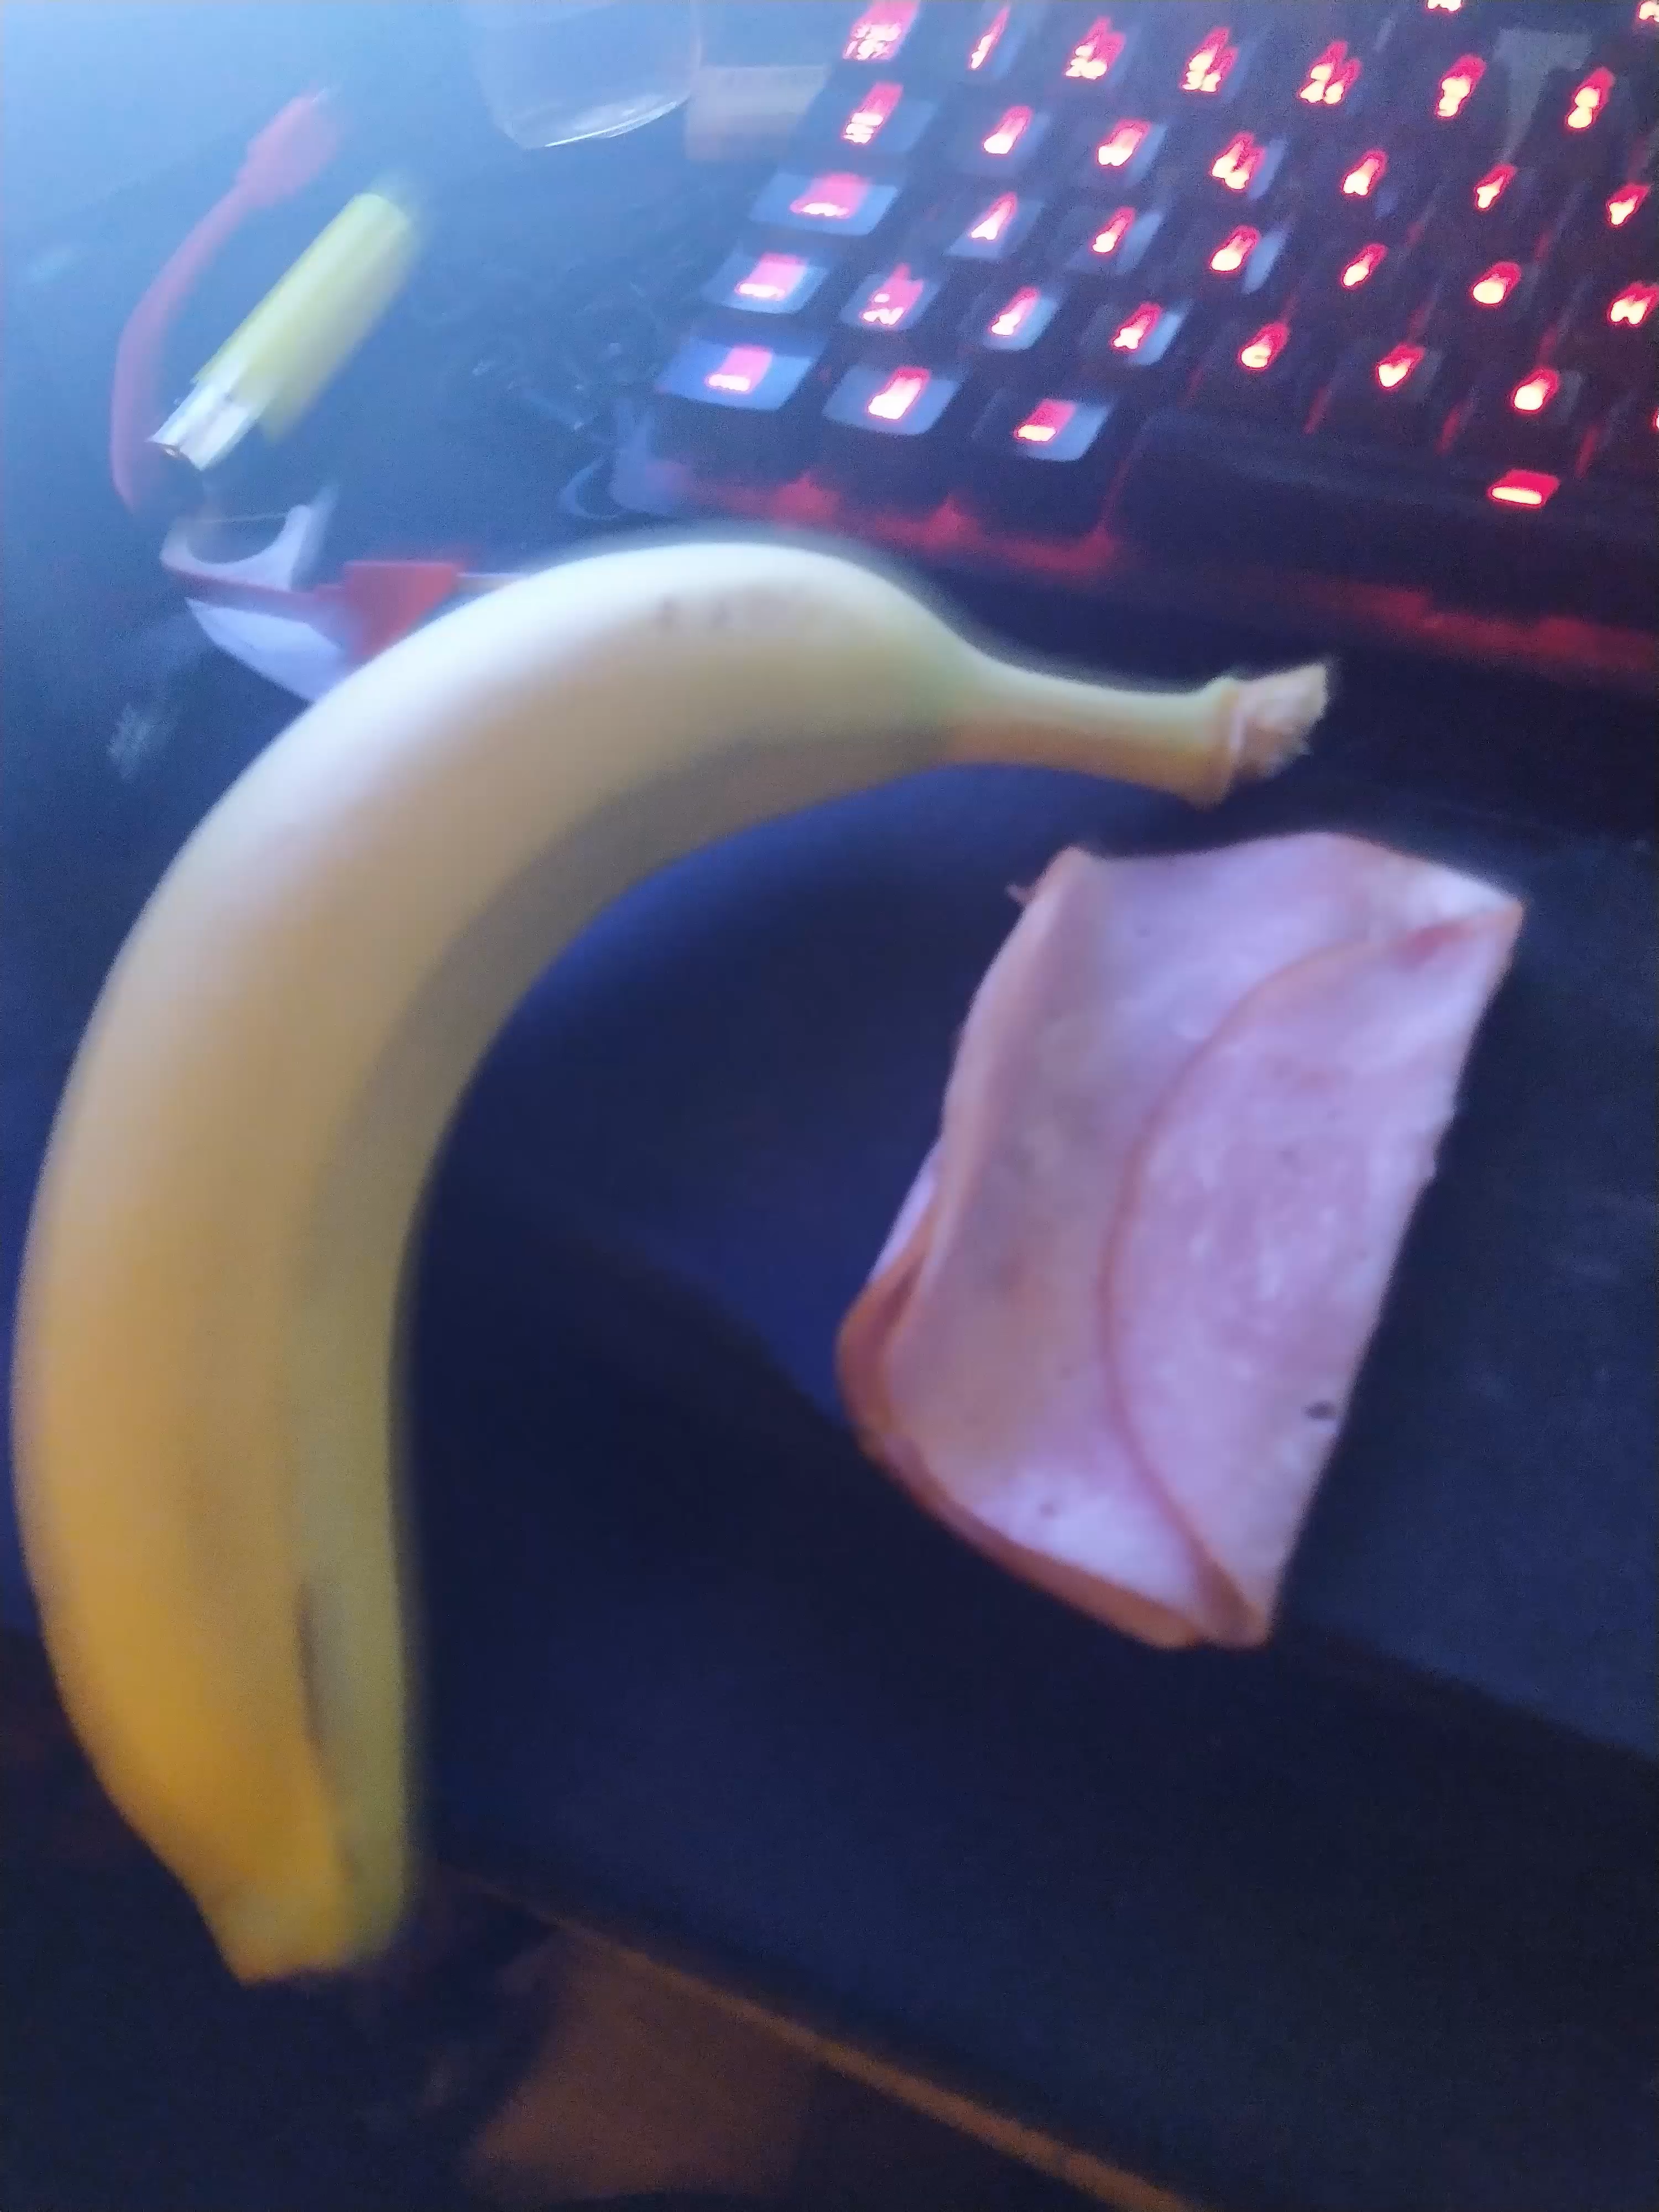

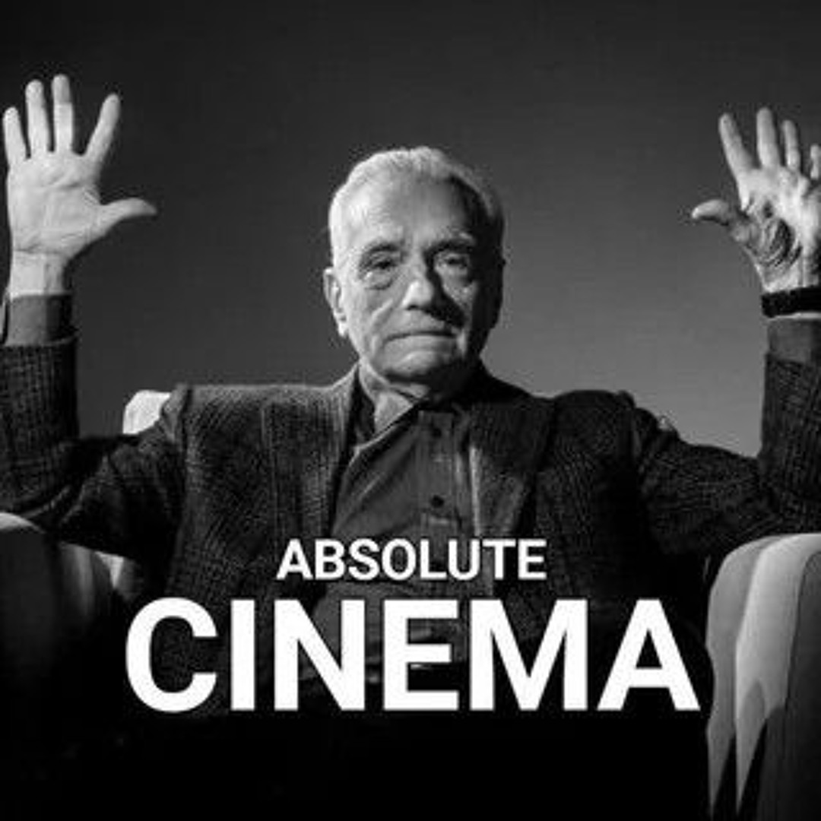
Learning achievement of this course
Learned use of Docker and Jenkins.
Learned about CI/CD principles.

Slide 13

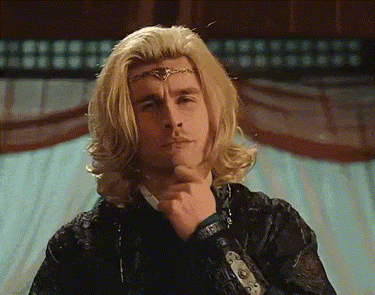

Plan for further development
Make improvements to UI
Make improvements to Filtering
Make notes customizable
Make improvements to Tests
Make unnecessary microtransactions, add unnecessary ads and unnecessary Ai

Slide 14
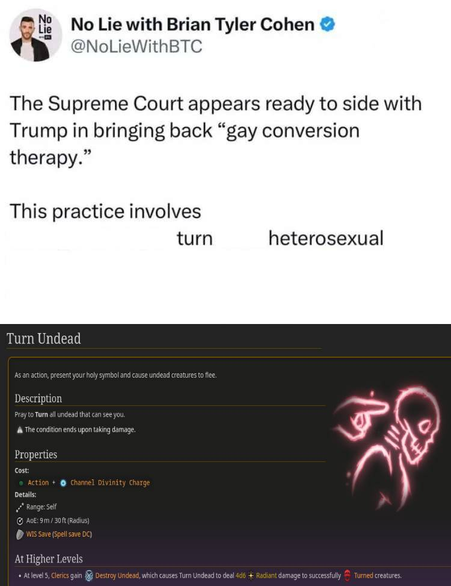
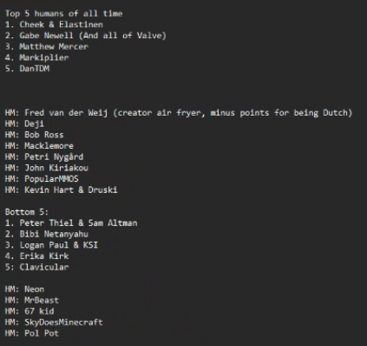


Thank you

